Slide 1


Final Presentation: Hurricanes and Their Impact on the Gulf Coast
Ibraheem Qureshi

Slide 2
Recap of Objectives
Temporal Hurricane Analysis: Conduct a temporal analysis of historical hurricanes in the Gulf Coast, focusing on tracking changes in frequency, intensity, and paths over time. This includes mapping hurricane trajectories and affected areas, providing a visual and statistical representation of hurricane activities and trends.
Population and Community Impact Assessment: Evaluate the impact of hurricanes on population centers, considering population density and urban development. Identify communities at increased risk due to frequent hurricane exposure and assess the socioeconomic implications, aiming to enhance community preparedness and response strategies.
Infrastructure Vulnerability Assessment: Assess the vulnerability of key infrastructure elements such as hospitals, power plants, and transportation facilities to hurricane impacts. Analyze spatial correlations between these infrastructures and hurricane zones to pinpoint high-risk areas and inform resilience-building strategies.

Slide 3
User Requirements + End Goal
Able to load the database in PostgreSQL
To then execute (spatial) queries to obtain meaningful insight
Connect the database to ArcGIS Pro to perform visual analysis based on previous queries
End result is a simple and streamlined process to make the best use of the geodatabase

Slide 4
Implementing the Database
Find shapefiles for historical hurricane tracks, cities, infrastructure, states
ESRI (ArcGIS Hub)
EIA (Energy Information Administration)
Miscellaneous sources
Create a new database in PostgreSQL (with PostGIS)
Data already populated, import feature classes
Ensuring to assign the appropriate SRID value for each
Conduct queries, visual examinations in ArcGIS pro to understand the behavior
Check for incomplete data, issues with formatting and spatial information
Repeat above steps as needed until the database is sufficiently functional

Slide 5
The Geodatabase (Design)
Name | Source | Geometry | Relevant Attributes
hurricanes | MapCruzin.com | line | name, year, wind_mph
usa_major_cities | ArcGIS Hub | point | name, population, families
states_shapefile | ArcGIS Hub | polygon | state_name, state_code
hospitals | HIFLD database | point | name, id, address, beds
petroleum_refinery | EIA | point | site_id, company, state
powerplants_us_eia | EIA | point | plant_code, plant_name
nautralgas_processingplants_us_2012 | Stanford Digital Repository | point | plant_name, state
Topological rules?
Relationships?
ER Diagram?

Slide 6
Applications of the Database (Let’s do some analysis with queries and ArcGIS Pro!)
Note: use the GROUP BY clause because of how the hurricane data is stored.

Slide 7
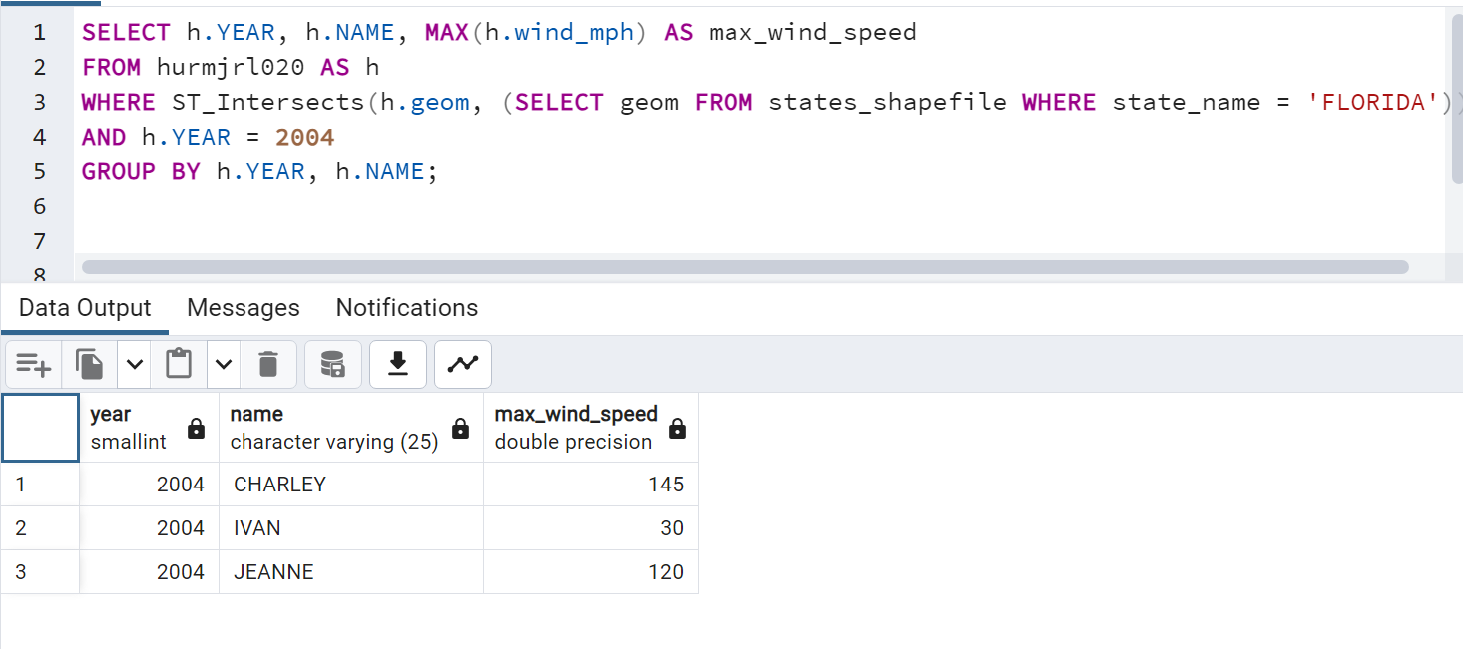

Which hurricanes made landfall over Florida in 2004? What was the maximum wind speed for these storms as they passed over?
Query:
SELECT h.YEAR, h.NAME, MAX(h.wind_mph) AS max_wind_speed
FROM hurmjrl020 AS h
WHERE ST_Intersects(h.geom, (SELECT geom FROM states_shapefile WHERE state_name = 'FLORIDA'))
AND h.YEAR = 2004
GROUP BY h.YEAR, h.NAME;
Result:

Slide 8
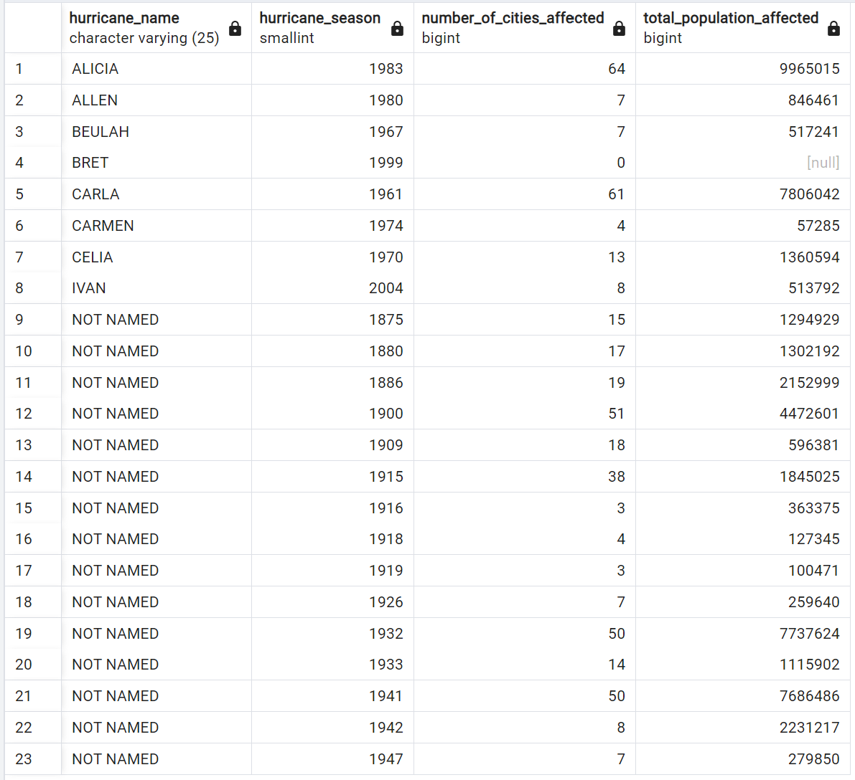
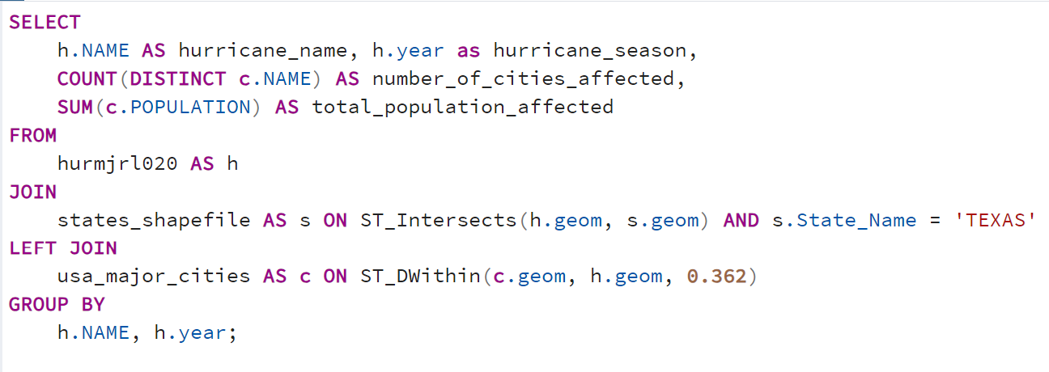
Which hurricanes (all time) have made landfall over Texas? How many cities were affected? What is the combined population of these cities?
SELECT
h.NAME AS hurricane_name, h.year as hurricane_season,
COUNT(DISTINCT c.NAME) AS number_of_cities_affected,
SUM(c.POPULATION) AS total_population_affected
FROM
hurmjrl020 AS h
JOIN
states_shapefile AS s ON ST_Intersects(h.geom, s.geom) AND s.State_Name = 'TEXAS'
LEFT JOIN
usa_major_cities AS c ON ST_DWithin(c.geom, h.geom, 0.362) -- Assuming 50 km as the distance threshold
GROUP BY
h.NAME, h.year;
Result:
Query:
Note: Spatial Reference is WGS 1984, which uses angular units (degrees). 1/69 degree = 1 mile

Slide 9
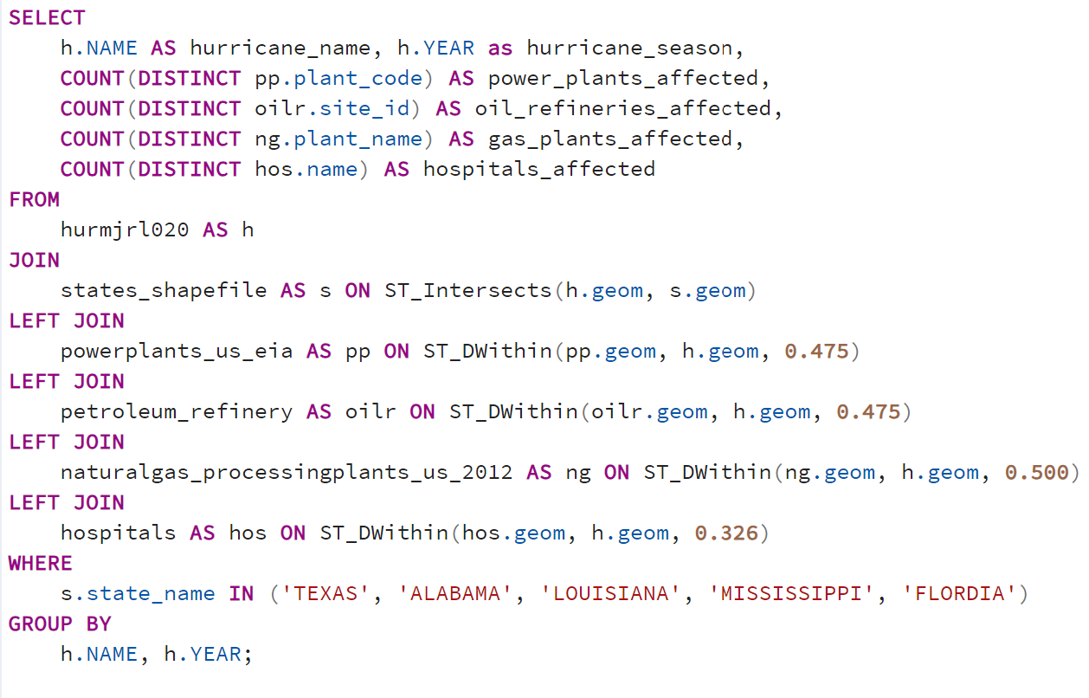
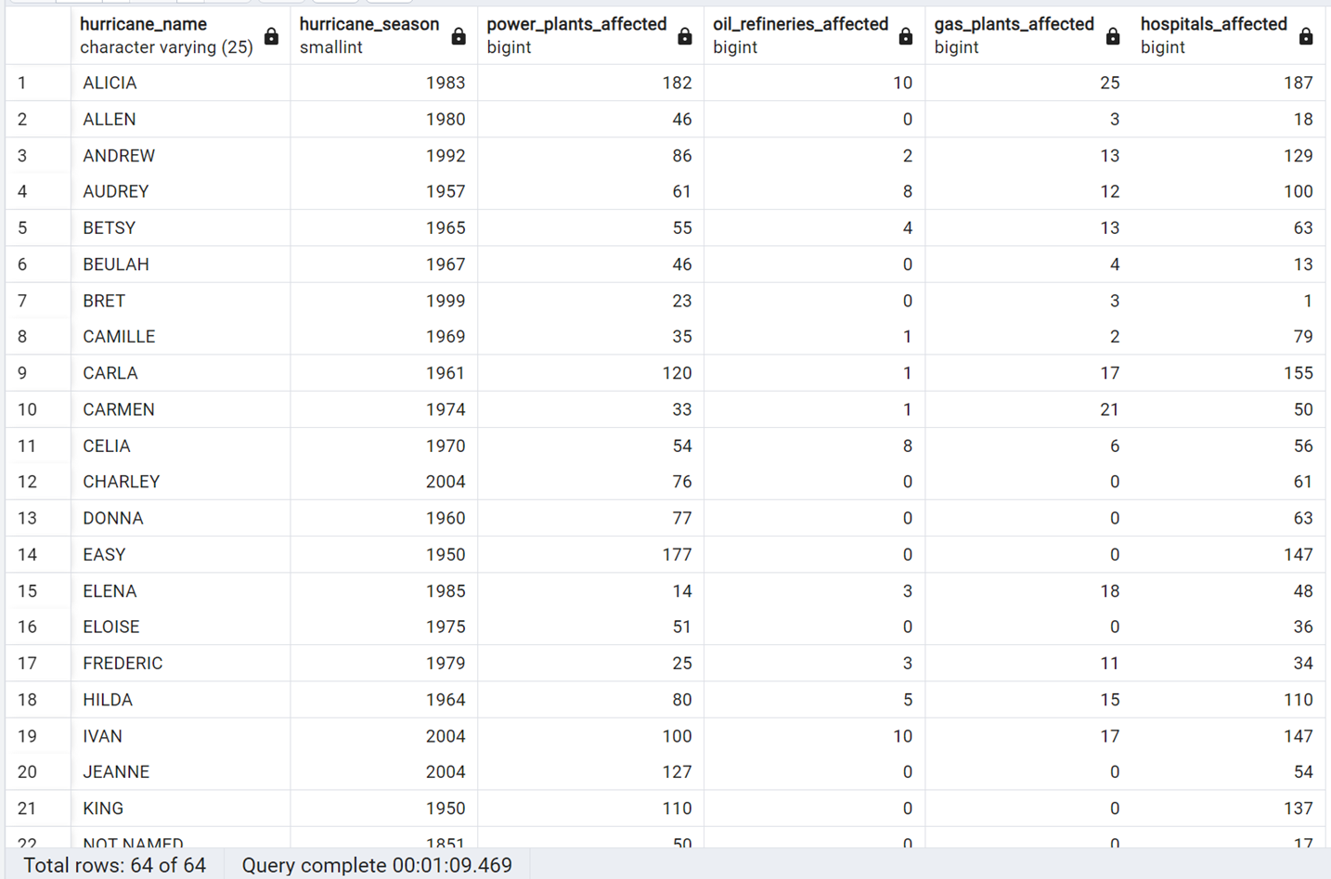
For all Gulf Coast-landfalling hurricanes, how many locations of different infrastructure types were affected?
SELECT
h.NAME AS hurricane_name, h.YEAR as hurricane_season,
COUNT(DISTINCT pp.plant_code) AS power_plants_affected,
COUNT(DISTINCT oilr.site_id) AS oil_refineries_affected,
COUNT(DISTINCT ng.plant_name) AS gas_plants_affected,
COUNT(DISTINCT hos.name) AS hospitals_affected
FROM
hurmjrl020 AS h
JOIN
states_shapefile AS s ON ST_Intersects(h.geom, s.geom)
LEFT JOIN
powerplants_us_eia AS pp ON ST_DWithin(pp.geom, h.geom, 0.475)
LEFT JOIN
petroleum_refinery AS oilr ON ST_DWithin(oilr.geom, h.geom, 0.475)
LEFT JOIN
naturalgas_processingplants_us_2012 AS ng ON ST_DWithin(ng.geom, h.geom, 0.500)
LEFT JOIN
hospitals AS hos ON ST_DWithin(hos.geom, h.geom, 0.326)
WHERE
s.state_name IN ('TEXAS', 'ALABAMA', 'LOUISIANA', 'MISSISSIPPI', 'FLORDIA')
GROUP BY
h.NAME, h.YEAR;
Result:
Query:

Slide 10
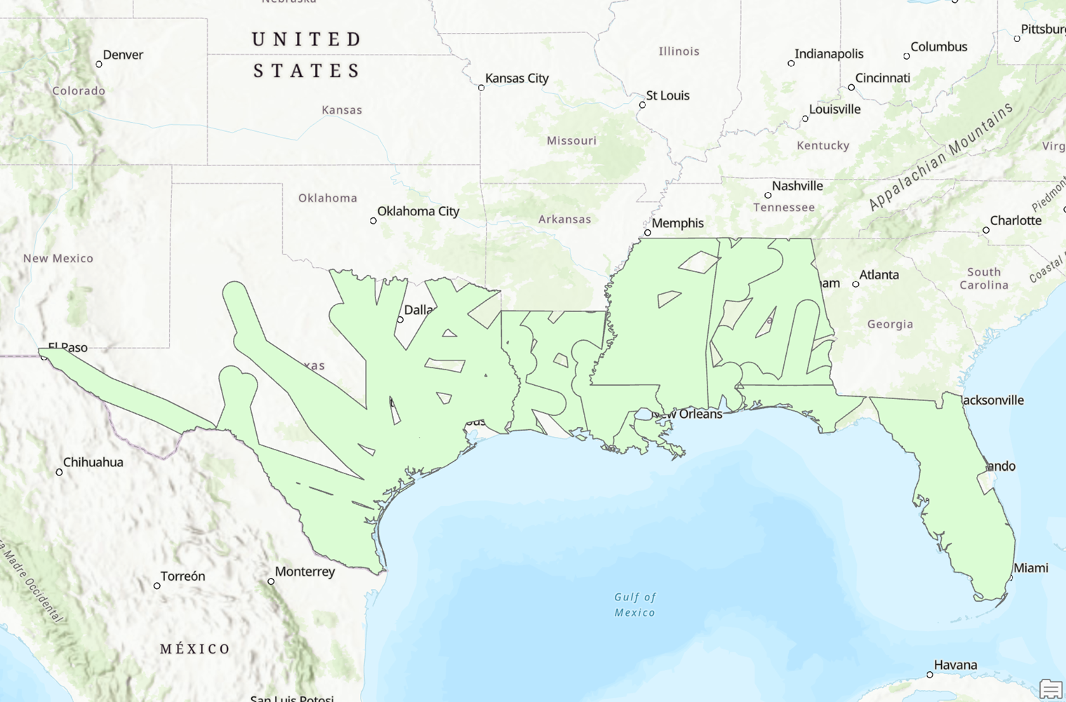
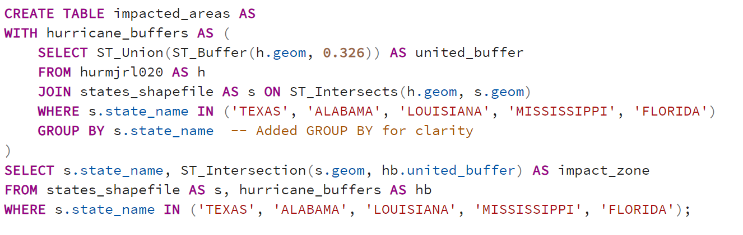
If we consider all hurricanes and their impacted areas in the region, what is the overall, combined impact area during the entire the time period?
CREATE TABLE impacted_areas AS
WITH hurricane_buffers AS (
SELECT ST_Union(ST_Buffer(h.geom, 0.326)) AS united_buffer
FROM hurmjrl020 AS h
JOIN states_shapefile AS s ON ST_Intersects(h.geom, s.geom)
WHERE s.state_name IN ('TEXAS', 'ALABAMA', 'LOUISIANA', 'MISSISSIPPI', 'FLORIDA')
GROUP BY s.state_name -- Added GROUP BY for clarity
)
SELECT s.state_name, ST_Intersection(s.geom, hb.united_buffer) AS impact_zone
FROM states_shapefile AS s, hurricane_buffers AS hb
WHERE s.state_name IN ('TEXAS', 'ALABAMA', 'LOUISIANA', 'MISSISSIPPI', 'FLORIDA');
Result:
Query:

Slide 11
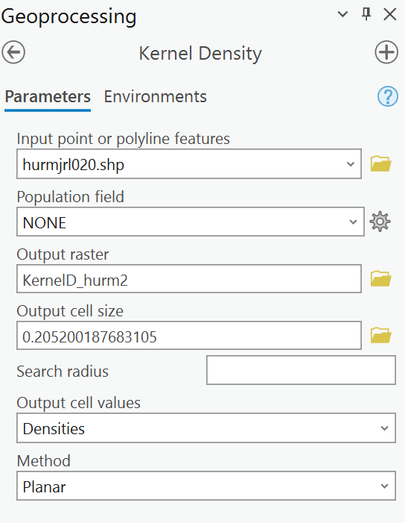
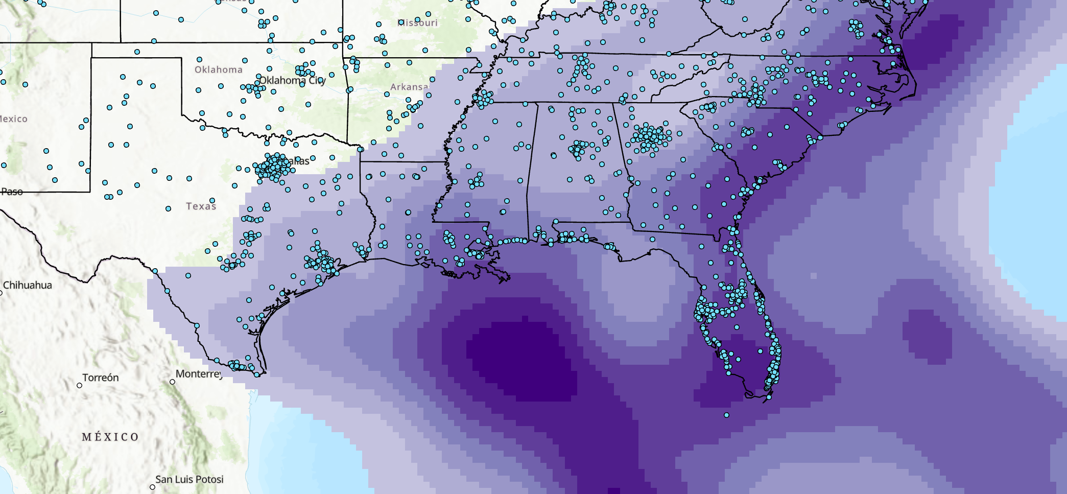
How can we visualize the concentration of hurricane landfalls in the region?
Result:

Slide 12
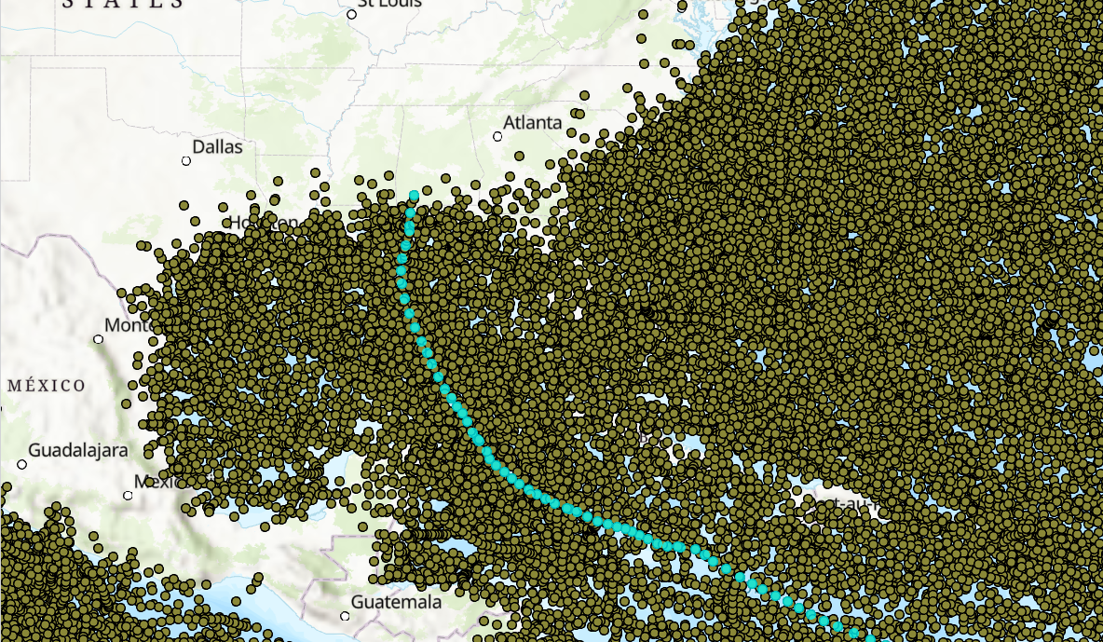
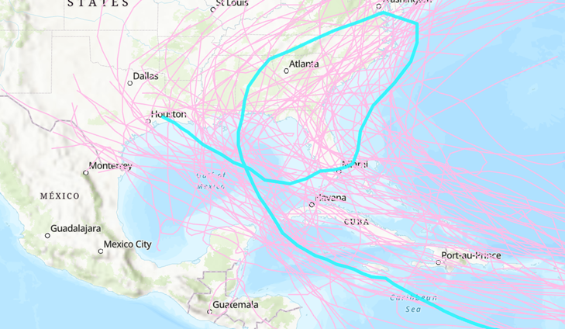
Challenges
Obtaining suitable data for historical hurricane tracks. Biggest Challenge!
Hard to find:
Up-to-date information
Line feature class
With valid geometry
What I had to settle with:
Check for incomplete data, issues with formatting and spatial information
A discrepancy in data (track of Hurricane Ivan 2004)
- Time period: 1851-2021
- Includes all Storms in all basins
- Point class
98,000 rows
- Time period: 1851-2004
- Landfalling Atlantic basin hurricanes
- Line class
4,000 rows

Slide 13
Challenges (Continued)
Hurricane feature class a priority! So, finding the other feature classes with the same spatial reference was tedious.
Lack of socio-economic datasets
Data cleaning/filtering?
Poor accessibility regarding ideal datasets
Root of all previously discussed issues!

Slide 14
Conclusion
Overall, a success.
Got the big picture, both quantitively and qualitatively
Able to tailor queries according to year, state, infrastructure of interest.
Can obtain even more detailed analysis through the use of spatial queries
Especially after gaining a greater in-depth understanding of PostGIS
Further refinement and expansion of data required to fufill full potential

Slide 15
Image Credits
https://pngimg.com/d/hurricane_PNG8.png
https://www.fws.gov/r7/nwr/Realty/data/LandMappers/Public/Help/HTML/lib/Icon-File-Geodatabase.png

